Slide 1

CSC 301 · GROUP 4 PROJECT
Shortest Path
Algorithms in Action
A comparative study of Dijkstra, Bellman-Ford, Floyd-Warshall, and A* on a 500-node city graph.
PRESENTED BY
Omar Fawzi Hawsawi · Leader
ID: 2240007072
Abdulaziz Khaled Alhassan
ID: 2240006848
Nawaf Khaled Alwabel
ID: 2240001111
Fahdel Abbas Al Asaad
ID: 2240002427
Mohammed Othman Alkhodir
ID: 2260040121
Mohammed Nasser Al-Marhoon
ID: 2240005893

Slide 2




01 · INTRODUCTION
Why Shortest Path Matters
Every time you open a GPS app, a hidden algorithm is racing to find the fastest route between you and your destination. Choosing the right one is the difference between an instant suggestion and a frozen screen.
Dijkstra
Bellman-Ford
GPS routing
Negative weights
Our project compares four well-known shortest-path algorithms on the same city graph to determine which one is the best fit for a real navigation system.
Floyd-Warshall
A*
Networking
Pathfinding
Group 4 · CSC 301 · Algorithm Analysis & Design
2

Slide 3
02 · PROBLEM DESCRIPTION
The Problem We Are Solving
THE PROBLEM
THE GRAPH MODEL
Travelers often take longer routes than necessary because they don't know which way is actually the shortest.
B
We are building a program that calculates and shows the shortest possible path between multiple locations on a city graph.
A
4
5
C
7
2
E
OUR GOAL
D
3
6
Determine which of the four algorithms gives the fastest, most reliable shortest path on a 500-city graph.
1
9
F
Shortest path · Total weight = 6
Group 4 · CSC 301 · Algorithm Analysis & Design
3

Slide 4
03 · ALGORITHMS
Four Approaches, One Problem
Each algorithm has a different trade-off between speed, flexibility, and accuracy.
Dijkstra
Bellman-Ford
Floyd-Warshall
A* (A-Star)
USE CASE
USE CASE
USE CASE
USE CASE
GPS / Navigation
Financial Networks
Network Infrastructure
Games / Pathfinding
KEY STRENGTH
KEY STRENGTH
KEY STRENGTH
KEY STRENGTH
Fastest reliable shortest path
Handles negative weights & shortcuts
Shortest paths between ALL nodes
Extremely fast goal-directed search
Group 4 · CSC 301 · Algorithm Analysis & Design
4

Slide 5
04 · DEEP DIVE
Dijkstra's Algorithm
How it works
PSEUDOCODE — ShortestPath(G, source)
1
Initialize
for each node n in G:
distance[n] = ∞
visited[n] = false
distance[source] = 0
while unvisited nodes exist:
u = node with min distance
visited[u] = true
for each neighbor n of u:
d = distance[u] + w(u,n)
if d < distance[n]:
distance[n] = d
return distance
Distance to start = 0, all others = ∞.
2
Pick
Choose the unvisited node with the smallest distance.
3
Relax
For each neighbor, compute distance through the current node.
4
Update
If the new path is shorter, replace it. Repeat until done.
Group 4 · CSC 301 · Algorithm Analysis & Design
5

Slide 6



05 · IMPLEMENTATION
How We Built & Tested It
Graph Construction
Algorithm Coding
Timing & Output
We generated a graph of 500 cities (City1 → City500) with weighted edges between neighboring cities. Each weight represents the distance between two locations.
All four algorithms were implemented in Python using the same input graph, so any differences in output come purely from the algorithm itself — not the data.
For each run we recorded the shortest path found, the total distance, and the computation time in seconds — our key metric for comparison.
THREE TEST CASES
Each algorithm was run on the same three queries to ensure a fair comparison:
City1 → City2 (short)
City1 → City250 (mid)
City1 → City500 (long)
Group 4 · CSC 301 · Algorithm Analysis & Design
6

Slide 7
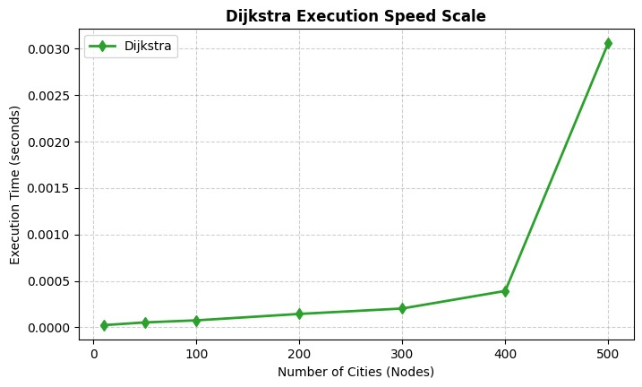
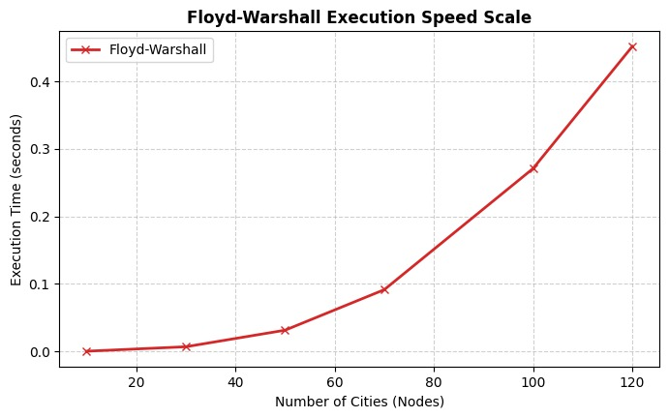
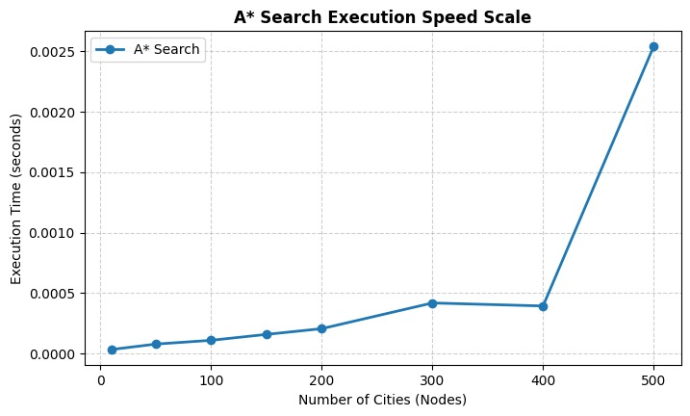
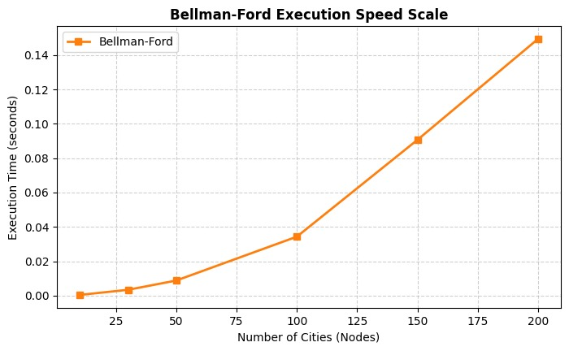
06 · RESULTS
Computation Time — The Verdict
Average computation time across three test cases (City1 → City2, City250, City500). Lower is better.
Dijkstra
0.004s
WINNER
A*
0.007s
FASTEST PEAK · RISKY
Bellman-Ford
1.91s
≈ 470× SLOWER
Floyd-Warshall
36.83s
≈ 9 000× SLOWER
Group 4 · CSC 301 · Algorithm Analysis & Design
7

Slide 8



07 · INTERPRETATION
What the Numbers Mean
≈ 0.004s
9 000×
500
Dijkstra's average
Floyd-Warshall slowdown
Cities in the test graph
Key insights
Dijkstra wins overall
A* is fast but inconsistent
Consistently fast across short, mid, and long queries — always finds the true shortest path. Complexity: Best case O(n log n), Worst case O(n²).
Slightly faster on tiny graphs, but its heuristic can lead it into dead-ends on larger queries. Complexity: Best case O(n), Worst case O(n²).
Bellman-Ford is overkill
Floyd-Warshall is unusable
Its ability to handle negative weights is wasted here — city distances are never negative. Complexity: Best case O(n²), Worst case O(n³).
37 seconds per query makes it impossible to use in a real navigation app. Complexity: Best case O(n³), Worst case O(n³).
Group 4 · CSC 301 · Algorithm Analysis & Design
8

Slide 9
08 · SIDE-BY-SIDE
Full Comparison Matrix
Algorithm
Primary Use
Key Strength
Main Weakness
Ranking
Dijkstra
GPS / Navigation
Always finds the shortest path efficiently.
Cannot handle negative weights.
Best
A* (A-Star)
Games / Fast Pathfinding
Extremely fast; uses a heuristic to find the goal.
Can get stuck in dead-ends if the guess is wrong.
Average
Bellman-Ford
Financial Networks
Can handle negative weights (shortcuts).
Much slower than Dijkstra.
Average
Floyd-Warshall
Network Infrastructure
Finds shortest paths between ALL nodes.
The slowest by a wide margin.
Worst
Rankings reflect suitability for our specific use case — a GPS-style city router.
Group 4 · CSC 301 · Algorithm Analysis & Design
9

Slide 10

09 · CONCLUSION
Our Final Recommendation
KEY TAKEAWAYS
BEST ALGORITHM
01
Speed wins
Dijkstra ran the same query 9 000× faster than Floyd-Warshall.
Dijkstra's
02
Right tool, right job
Every algorithm is good at something — but only one fits our problem.
Algorithm
03
Tested on real data
Three queries, four algorithms, identical 500-city graph.
Fastest. Most reliable. Already trusted by every major GPS app on the planet.
04
Production-ready
Dijkstra scales cleanly and gives a correct shortest path every time.
Group 4 · CSC 301 · Algorithm Analysis & Design
10

Slide 11

Questions?
We'd love to hear what you think.
Thank you for listening
Group 4 · Section 1 · CSC 301 — Algorithm Analysis & Design

